Slide 1
MOBILE COMPUTING AND ITS APPLICATIONS
Presented by:- Priyanka Pandey
MCA 1st year

Slide 2
CONTENT
Introduction to mobile computing
Components of mobile computing
Wired v/s wireless network
Architecture of mobile computing
Applications of mobile computing
Issues in mobile computing

Slide 3
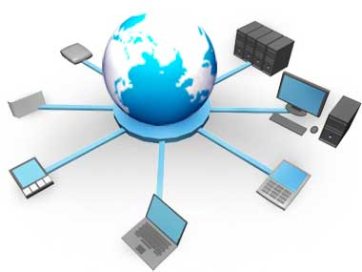
Introduction to mobile computing
Mobile Computing is a technology that provides an environment that enables users to transmit data from one device to another device anytime, any place and anywhere without the use of any physical link or cables.
It facilitates the user to move
from one physical location
to another during communication.

Slide 4
Components of mobile computing
Mobile Communication
Mobile Hardware
Mobile Software

Slide 5
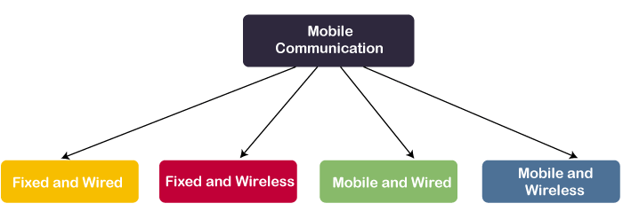
Mobile communication
Mobile Communication is the use of technology that allows us to communicate with others in different locations without the use of any physical connection (wires or cables).
Desktop computer Communication Towers, Laptop Wi-fi
WiFi router Dongle

Slide 6
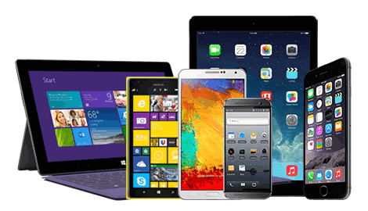
Mobile hardware
Mobile hardware consists of mobile devices or device components that can be used to receive or access the service of mobility. Examples of mobile hardware can be smartphones, laptops, portable PCs, tablet PCs, Personal Digital Assistants, etc.
These devices are capable of operating in full-duplex. It means they can send and receive signals at the same time. They don't have to wait until one device has finished communicating for the other device to initiate communications.

Slide 7
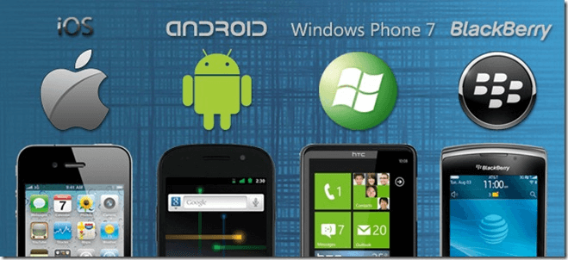
MOBILE SOFTWARE
Mobile software is a program that runs on mobile hardware.
This is designed to deal capably with the characteristics and requirements of mobile applications.
Since portability is the main factor, this type of computing ensures that users are not tied or pinned to a single physical location, but are able to operate from anywhere. It merge all aspects of wireless communications.

Slide 8
Fixed vs wireless networks
Wirless Network
Fixed Network
There is no requirement of any physical configuration in the wireless network.
The data loss rate is high in Wireless Networks.
In Wireless Networks, the data transmission rate is comparatively low, so it provides less speed.
The Wireless Networks may be hacked; that's why the security is always low in this type of network.
In Fixed Networks, a physical configuration is required in any condition.
In Fixed Networks, a perfect link is established between the devices, so; the data loss rate is very low.
In Fixed Networks, the rate of data transmission is high, so it provides high speed.
Fixed Networks connections are highly secured.

Slide 9
3 tier architecture of mobile computing
Presentation Tier: It is the user interface and topmost tier in the architecture. Its purpose is to take request from the client and displays information to the client. It communicates with other tiers using a web browser as it gives output on the browser. If we talk about Web-based tiers then these are developed using languages like- HTML, CSS, JavaScript.
Application Tier: It is the middle tier of the architecture also known as the logic tier as the information/request gathered through the presentation tier is processed in detail here. It also interacts with the server that stores the data. It processes the client’s request, formats, it and sends it back to the client. It is developed using languages like- Python, Java, PHP, etc.
Data Tier: It is the last tier of the architecture also known as the Database Tier. It is used to store the processed information so that it can be retrieved later on when required. It consists of Database Servers like- Oracle, MySQL, etc. The communication between the Presentation Tier and Data-Tier is done using middle-tier i.e. Application Tier.

Slide 10
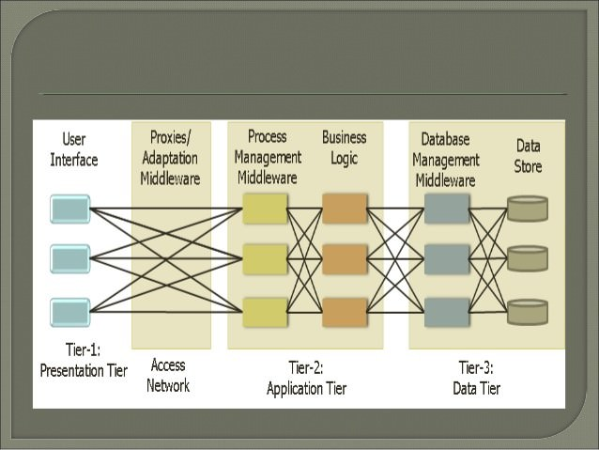

Slide 11
Applications of mobile computing
E-governance.
Educational services.
Tourism.
Emergencies.
Credit card verifications during shopping.
Manage personal records

Slide 12
Issues in mobile computing
Costlty due to wireless medium.
Issues due to device mobility.
Security issues.
Connectivity and reliability issues.

Slide 13
References
https://www.javatpoint.com/mobile-computing
https://www.geeksforgeeks.org/wireless-mobile-computing-technologies/
THANK YOU

